Slide 1





Lecture 1: This Course and Neural Network
Basics
Feng-Lei Fan (FAN: Frontier of Artificial Networks)
Assistant Professor, City University of Hong Kong

Slide 2
Outline
Efficiency is All You Need
Outline

Slide 3
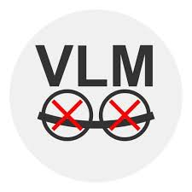
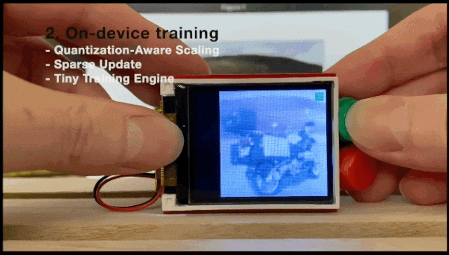

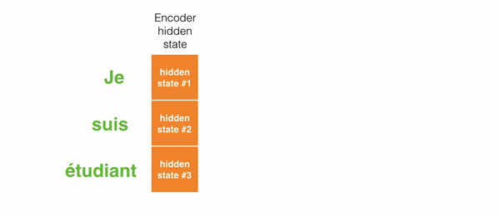

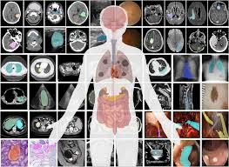
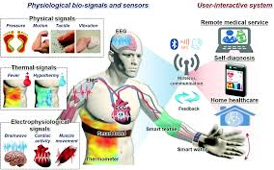
Background
Foundational Modules
Large & Small Models
Applications
Deployment

Slide 4
Background
Parameters (B)
$${10}^{5}$$
$${10}^{4}$$
PanGu-$Σ$
abab-6.5
$${10}^{3}$$
ChatGPT
PanGu-$α$
BLOOM
Grok-1
GPT-3
M6
FLM
Galactica
$${10}^{2}$$
OPT
TPUv3
32GB
Turing-NLG
NLLB
LLaMA
V100
32GB
T5-11B
ViT-Base
CPM-2
Pythia
$${10}^{1}$$
TPUv2
16GB
mT5
Megatron-LM
A100
40GB
A100
80GB
H100
94GB
Mistral-7B
GPT-2
$${10}^{0}$$
BERT-L
Swin-L
Hardware growth is slow!
Transformer
ELMo
BERT-B
$${10}^{−1}$$
RedNet-152
ResNet-1202
NAS-Net-A(7@2304)
$${10}^{−2}$$
DenseNet
Shuffle-Net
ResNet-110
Mobile-Net
DARTS
Year
$${10}^{−3}$$
2017
2018
2019
2020
2021
2022
2023
2024
2025

Slide 5
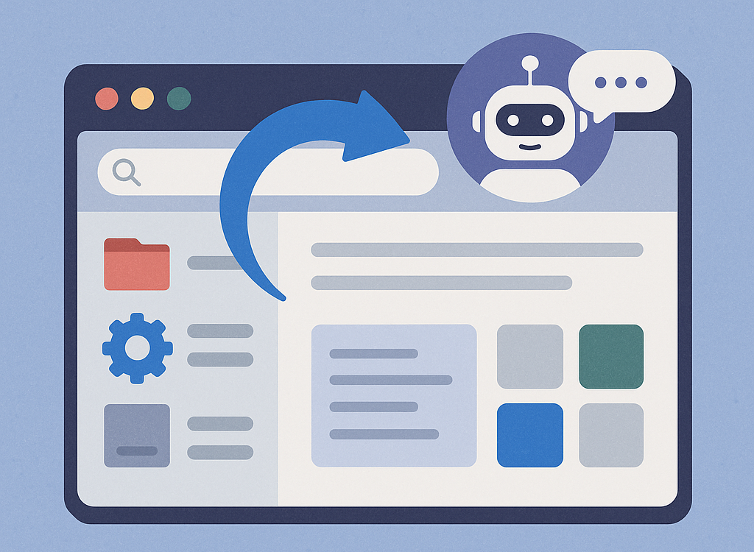
AI Operating System
Hyper compression reduces computational demands and deployment costs, paving the way for the integration of AI agents into operating systems, potentially revolutionizing the existing software ecosystem.
Tokenized Software Instructions
Revolutionary upgrade of the software ecosystem
Adaptive System Intelligence

Slide 6
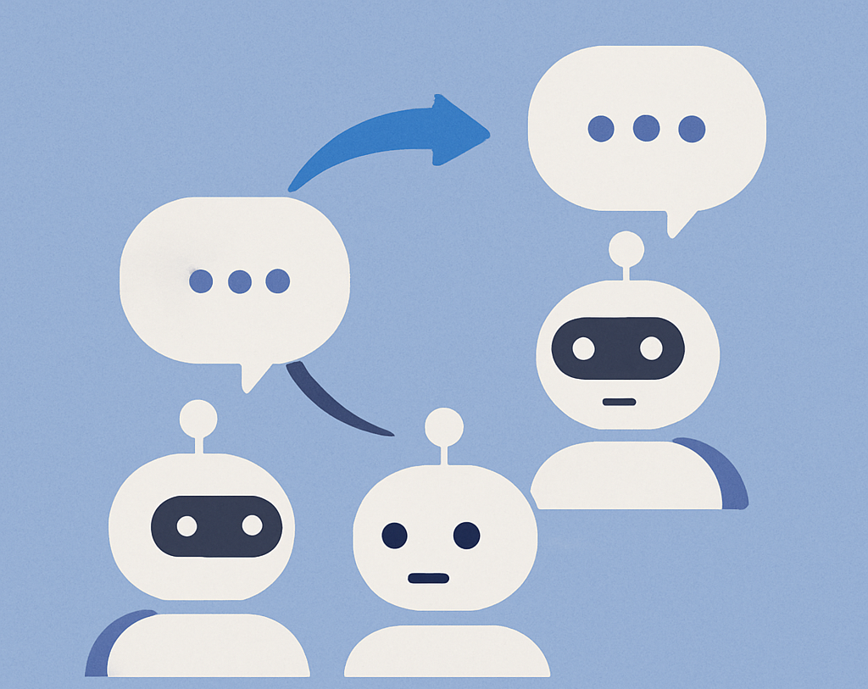
Sociological Simulation
Hyper compression holds promise for large-scale deployment of AI-driven sociological simulation experiments, effectively overcoming the long-standing challenge of conducting practical sociology experiments.
UN-Scale scenario rehearsal
Ethical experimentation
Policy testing & forecasting

Slide 7

Personalized AI
Hyper compression is expected to drive the development of personalized AI, breaking the monopoly of large corporations and truly empowering every individual.
Personalized AI for all
Breaks big tech monopoly
Empowers edge Intelligence

Slide 8
Outline
Review Syllabus
Outline

Slide 9
Outline
Neural Network Basics: Structure
Outline

Slide 10
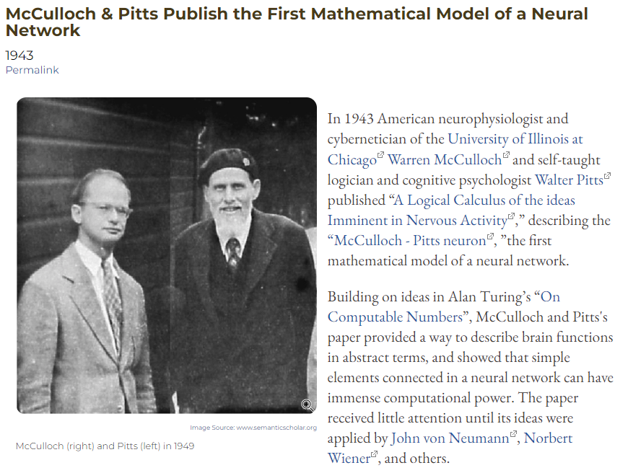
Artificial Neurons
Branches (Dendrite)
Body (Soma)
Synapsis
Fiber (Axon)
Input
Output
Biological Neuron
Summation (Linear)
Weight
Transformation (Nonlinear)
Input
Output
Artificial Neuron

Slide 11
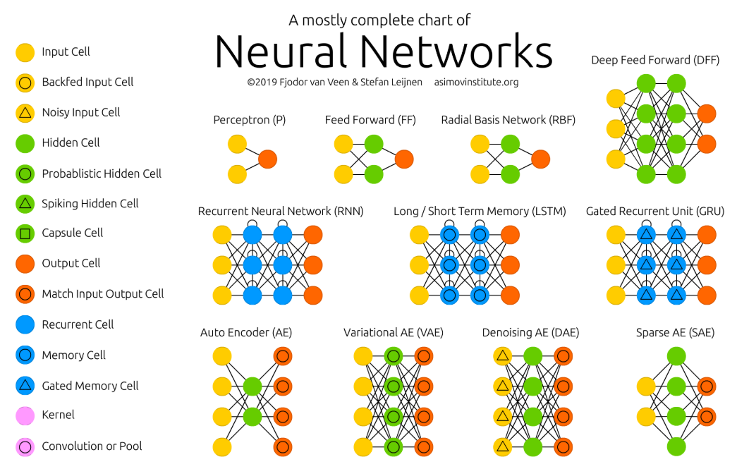

Slide 12
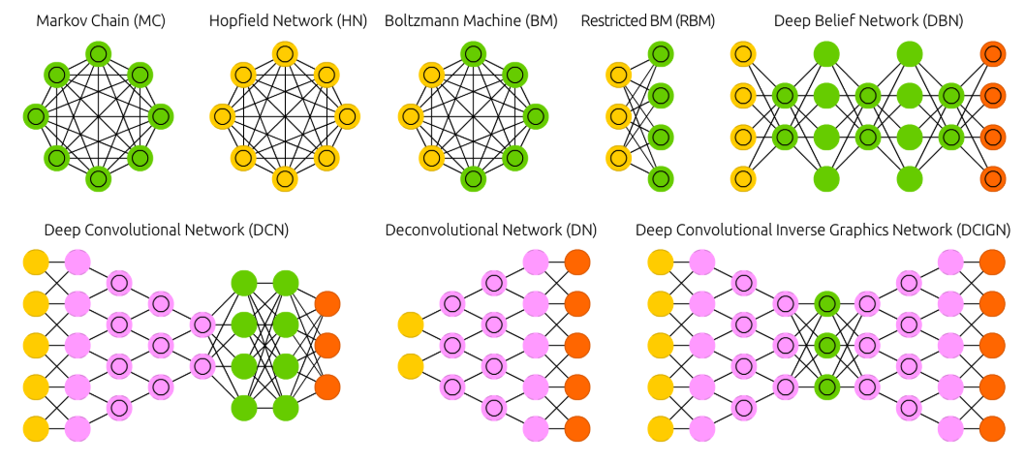

Slide 13
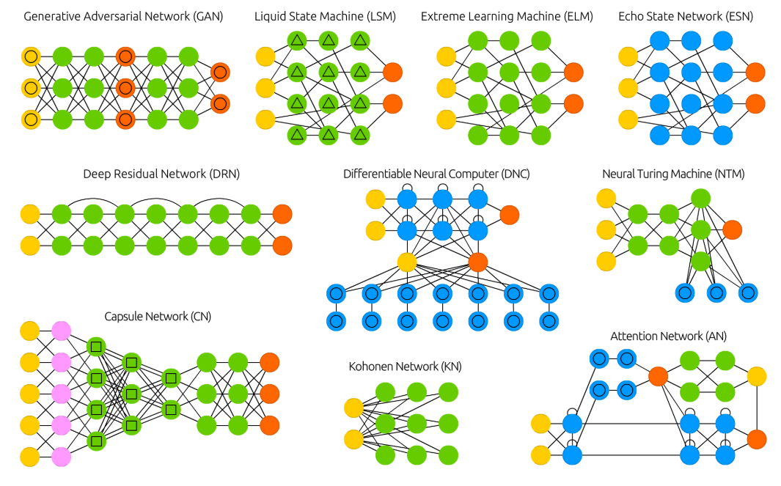

Slide 14
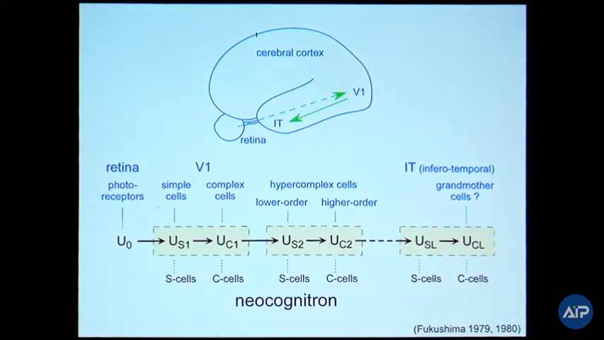
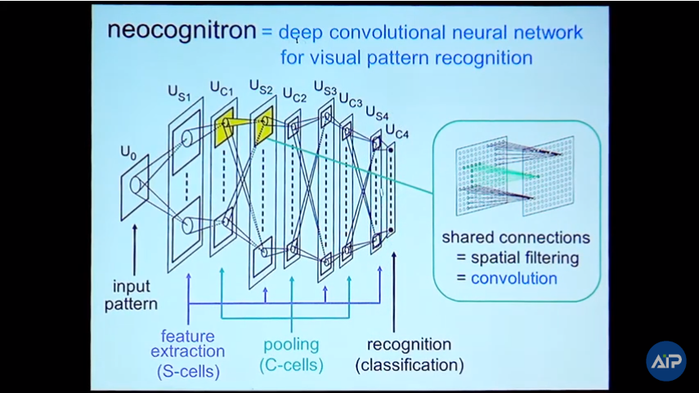
Neocognitron
Neocognitron, invented in 1979 by Kunihiko Fukushima, is the pioneering work of Convolutional Neural Networks.
Hierarchical Information Processing in the Layered Network

Slide 15
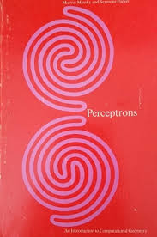
Neural Network Historical Ups and Downs

Slide 16
A Neuron
Branches (Dendrite)
Body (Soma)
Synapsis
Fiber (Axon)
Input
Output
Biological Neuron
Summation (Linear)
Weight
Transformation (Nonlinear)
Input
Output
Artificial Neuron

Slide 17
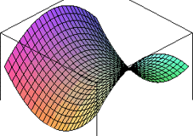
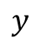
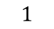
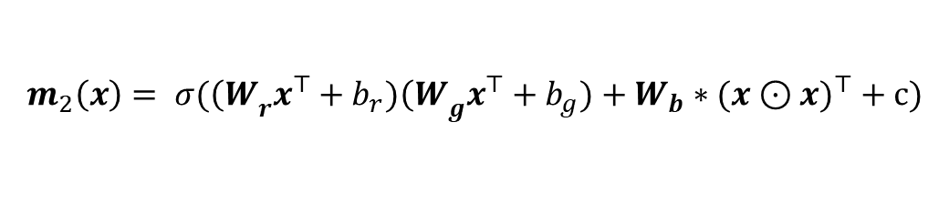
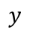
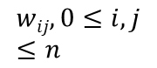
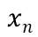
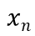

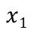

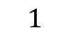

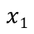
Conventional Neuron
Quadratic Neuron
$$1$$
Linear
Nonlinear
Nonlinear
Nonlinear
$$1$$
$$w0$$
$$wij, 0≤i,j≤n$$
$$x1$$
$$w1$$
$$y$$
$$x1$$
$$y$$
Input
Output
Input
Output
…
$$wn$$
…
$$xn$$
Inner Product
$$xn$$
Quadratic Form
Activation
$$m_{2}\left(x\right)= σ({\left(W\right.}_{r}x^{⊤}+b_{r}){\left(W\right.}_{g}x^{⊤}+b_{g})+W_{b}∗(x⊙{x)}^{⊤}+c)$$
Fan, F., Cong, W. and Wang, G., 2018. A new type of neurons for machine learning. International journal for numerical methods in biomedical engineering, 34(2), p.e2920.
Quadratic neuron is upgraded the conventional neuron, which integrates input data into an inner product, into the quadratic neuron that processes the n-dimension inputs as follows:
$$\begin{aligned}h\left(x\right)=(\sum_{i=1}^{n}{w_{ir}x_{i}}+b_{r})(\sum_{i=1}^{n}{w_{ig}x_{i}}+b_{g})+\sum_{i=1}^{n}{w_{ib}x_{i}^{2}+c} \\ =\left(w_{r}x^{T}+b_{r}\right)\left(w_{g}x^{T}+b_{g}\right)+w_{b}{\left(x^{2}\right)}^{T}+c\end{aligned}$$
where only 3n parameters are used.

Slide 18
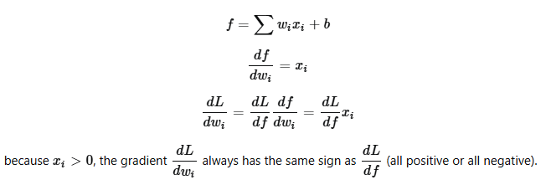
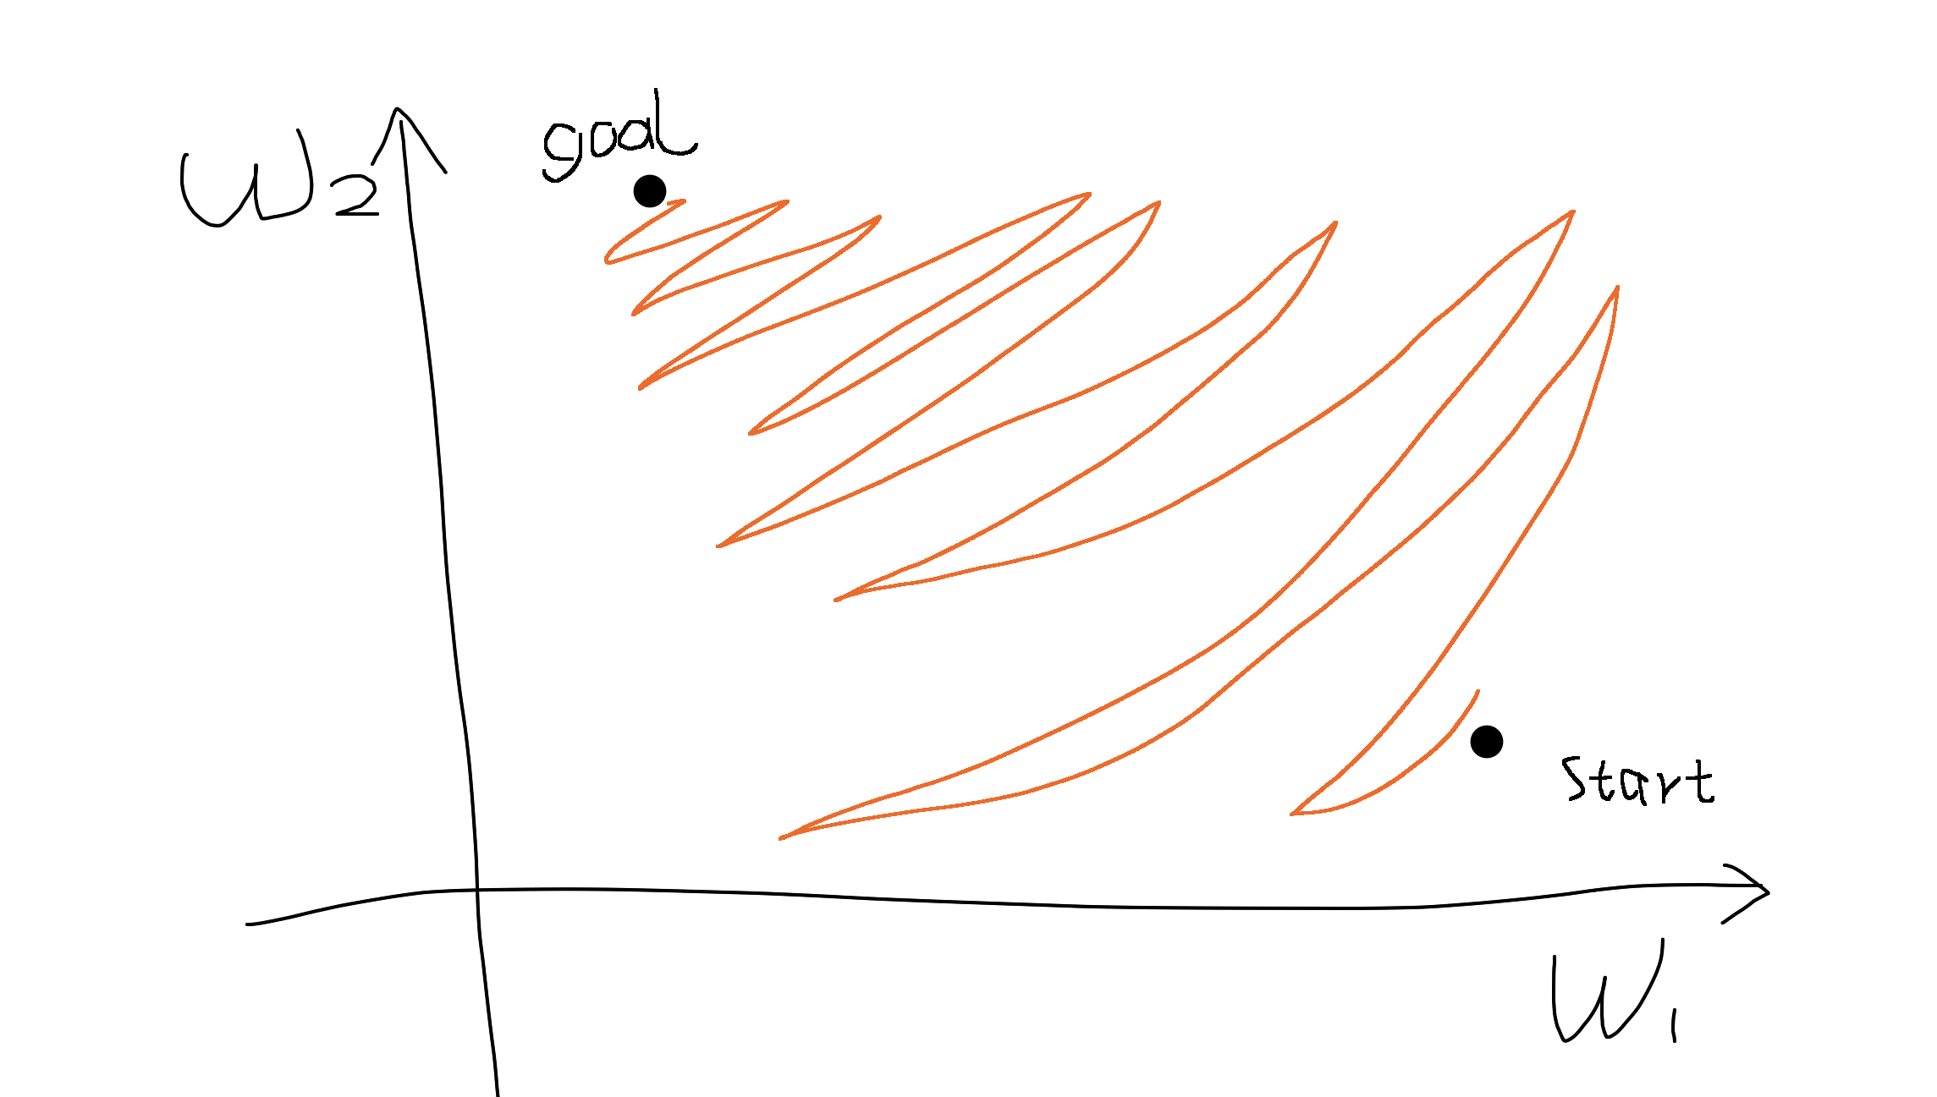
Zero-Centered Activation Function

Slide 19
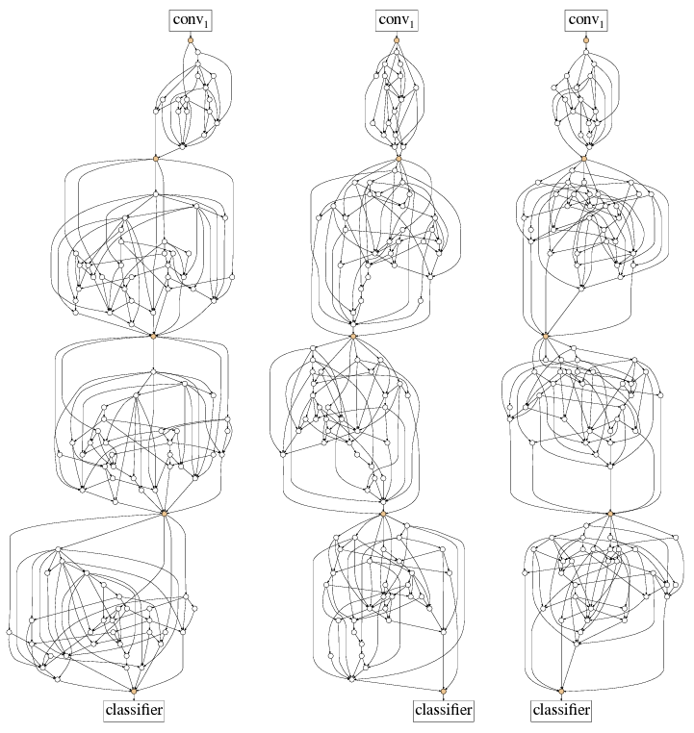
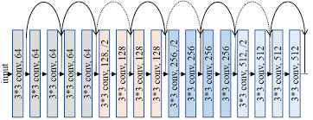
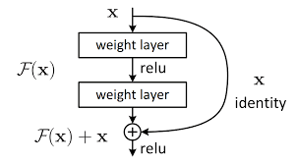
Residual Link

Slide 20
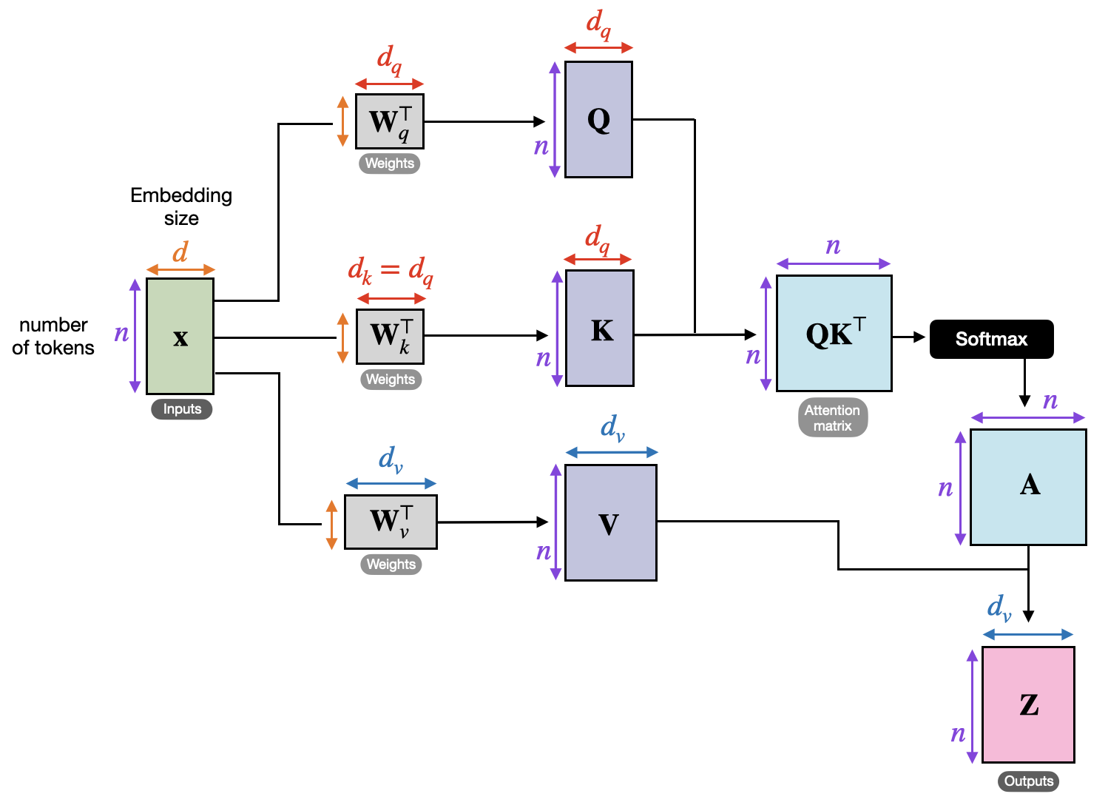
Self-Attention

Slide 21
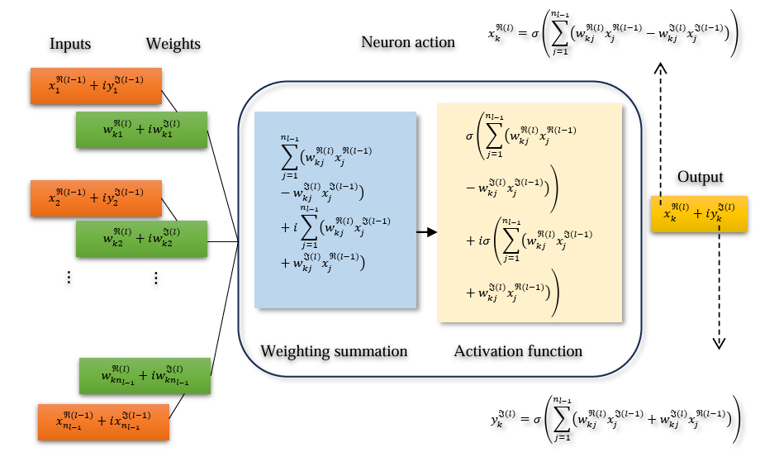
Complex-Valued Networks

Slide 22
Outline
Neural Network Basics: Training
Outline

Slide 23
Outline
Neural Network Basics: Learning Modalities
Outline

Slide 24
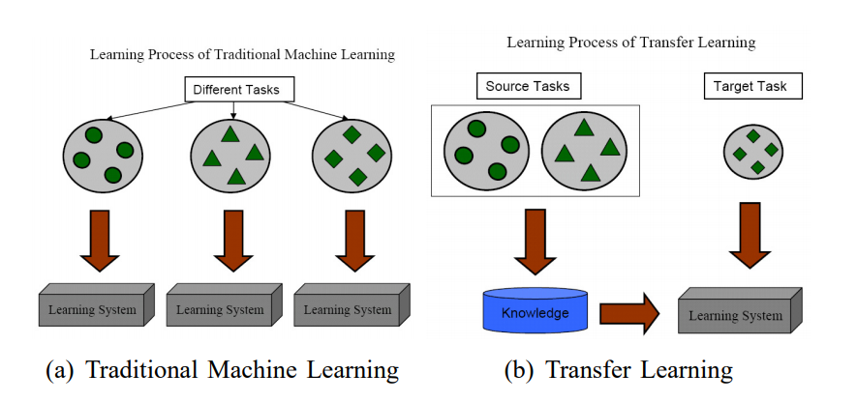
Transfer Learning

Slide 25
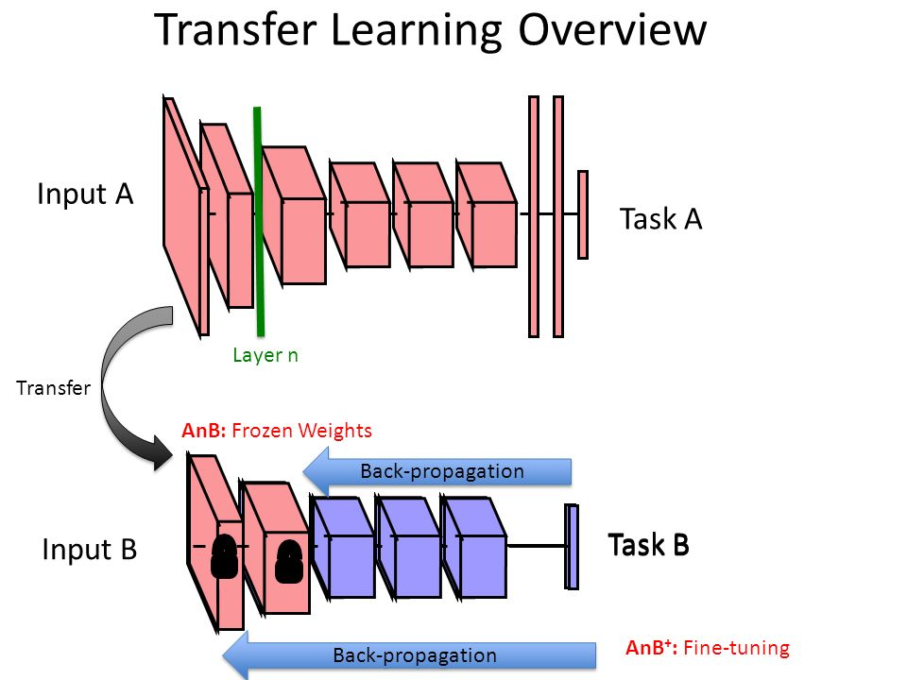
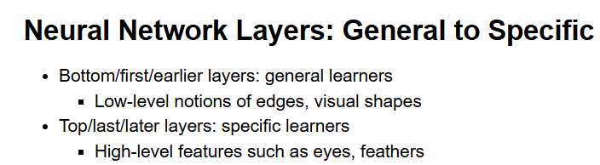
Transfer Learning

Slide 26
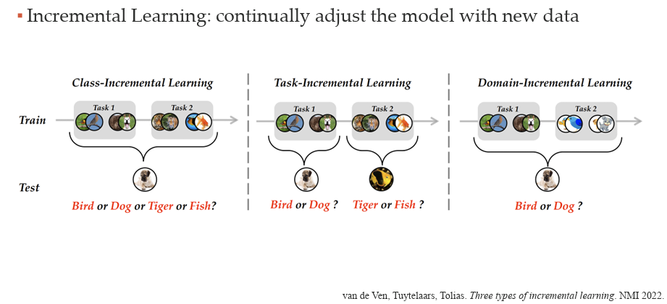
Increment Learning

Slide 27
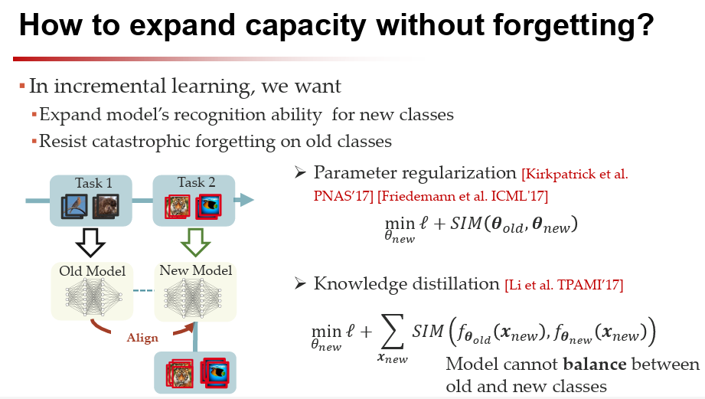
Increment Learning

Slide 28
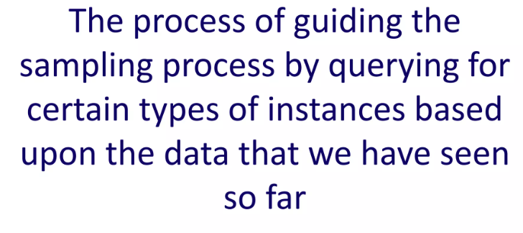
Active Learning

Slide 29
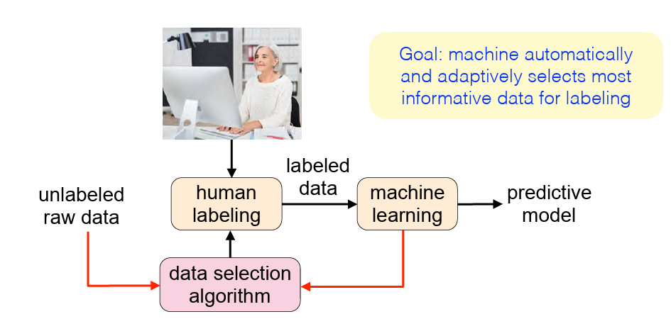
Active Learning

Slide 30
Curriculum Learning
Curriculum learning is a training strategy that trains a model starting with easier data and ending with harder data, which analogues the learning order in human curricula

Slide 31
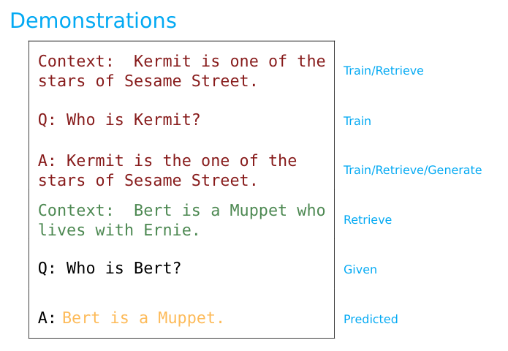
In-Context Learning

